Slide 1
D16 HelpingGrads
Group Members: Shamanth Chedde, Jun Zheng, Syed Sharjeel Haider, Gaurav Sharma, Nikisha Jeyakumar, Muskan Patpatpia
TA: Jaisie Sin

Slide 2
Design Process
Formative
Study
Low-Fidelity
Prototypes
High-Fidelity
Prototypes
Identifying Problem
Space
Usability Testing
Notes:
For our design process we highlighted five major steps; identifying the problem space, conducting a formative study, creating low fidelity prototypes, (and testing them??), refining them into a high fidelity prototype and lastly conducting a usability testing. We will explain these steps more in depth

Slide 3
Problem Space
Graduate school application process
Application process can be stressful
Help make the application process less tedious or complicated
Target Audience
Individuals applying to graduate level education programs
Notes:
The problem space we are addressing is the graduate school application process. The application process can be very stressful due to the amount of materials required for an application. There is the personal statement, the resume, reference letters, some students need to write admissions tests like the MCAT.
The problem space we are addressing has to do with graduate school application process. The sole thought of upper-year education, let alone the countless number of questions, essays, and references needed to complete an application, can certainly stress students out. With our target audience of post-secondary students and instructors in mind, our goal is to create a solution so that the application process can become less tedious/complicated for both parties.

Slide 4
User Needs Analysis
Conducted research through surveys, interviews, academic research papers
Obtained information pertaining to:
Participant demographics
Procedures of applying
Documents that were required
What the waiting process is like
What the experience was like for them overall
Notes:
To figure out our user’s needs, we initially conducted surveys and interviews to gather information that allowed us to understand the students’ experiences and their real needs regarding graduate school applications. We asked them questions pertaining to the procedures of applying, what types of documents were required or were needed to be filled out, what the waiting process is like, what the experience was like for them overall as well as obtained participant demographics.

Slide 5
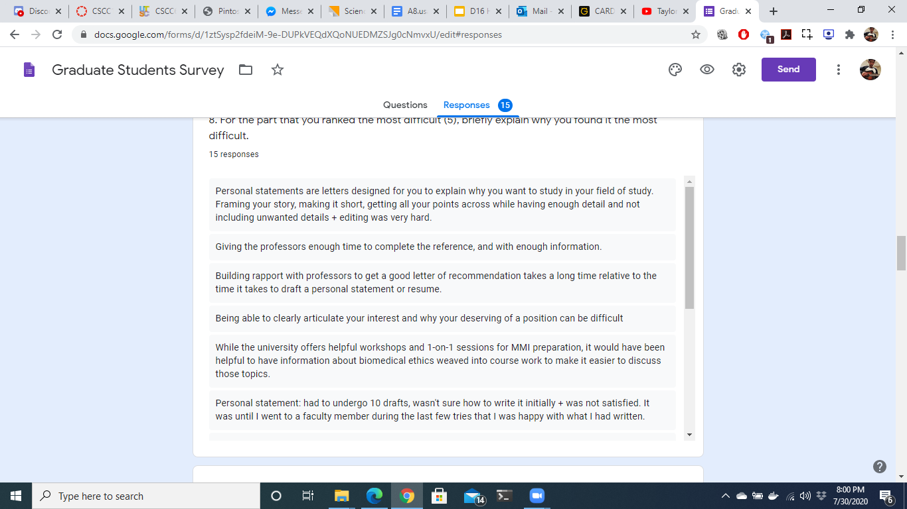
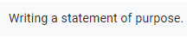
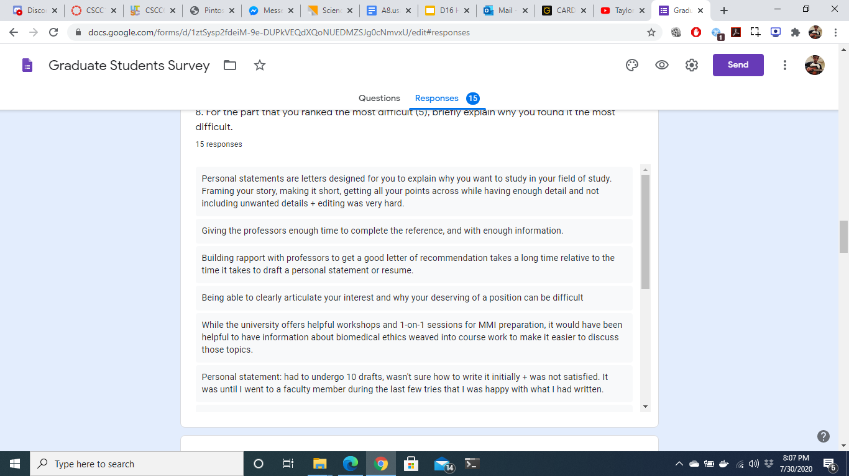
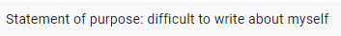
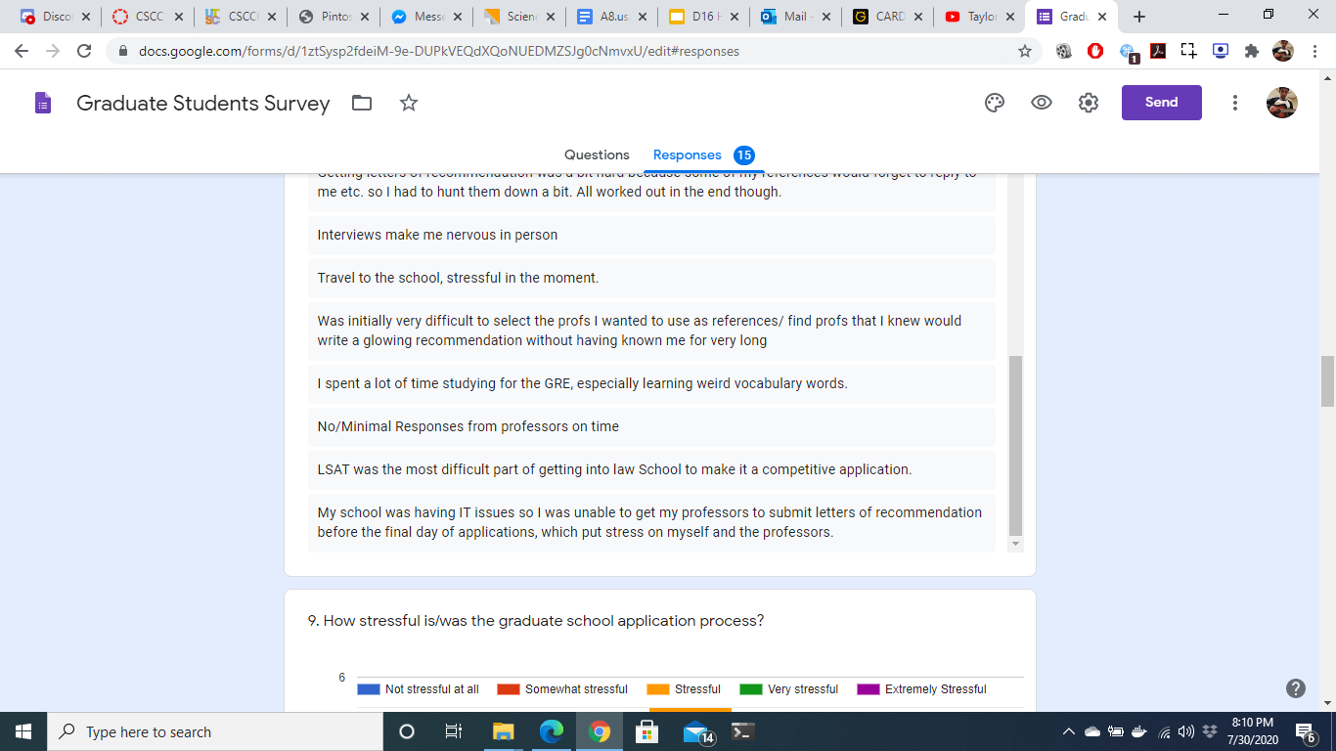
“What is the most difficult part about the application process?”
Notes:
One major we found was that people had difficulty with their personal statement and collecting letters of recommendation as evidenced by these quotes from our surveys and interviews.

Slide 6
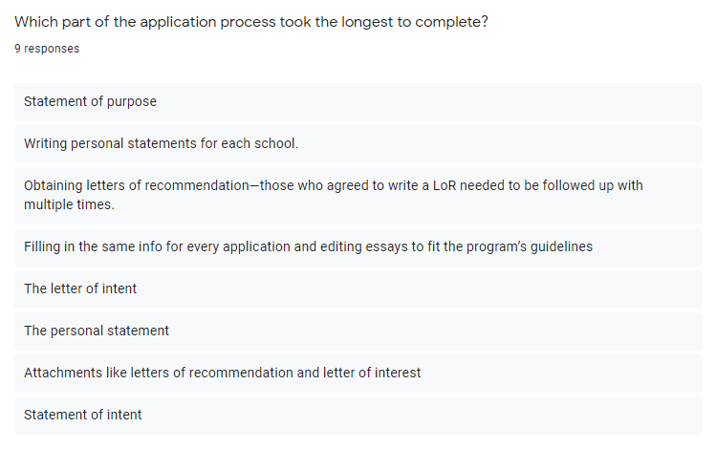
“Which part of the application process took the longest to complete?”
Notes:
Another major theme was that people found that the personal statement and letters of recommendation took the longest as well. It makes sense that the personal statement and letters of recommendation were the most difficult and took the longest as they are both very important pieces of the application and students feel the need to nail these two pieces, especially the personal statement since that is what helps students stand out from the others.

Slide 7
Initial Solution
A centralized application hub where the users can apply to their programs and the application would take care of the organization and document tracking.
Notes:
(Jun)

Slide 8


THE DILEMMA...
Our solution requires buy-in from the universities to partner with our application. This seems to be unrealistic as many universities prefer to manage their own application portals and may not want to take on the hassle of a new integration.
Notes:
(Jun) Some universities may be reluctant to partner with us as they have their process and may not want to change it, among other reasons. So it seemed unrealistic for other universities to connect their systems with ours.

Slide 9
The Solution
A web application that provides resources to help prospective graduate students prepare their applications and connect with the graduate school community
Notes:
(Jun)

Slide 10
Personas/Scenarios
Sally
A 4th year computer science student who plans to get into artificial intelligence research as a career and will soon be applying for graduate schools Being a newbie to the graduate school process she is looking forward to finding helpful resources that will guide her with the document completion and university selection process.
Key Scenario #1
Sally is having trouble finding the right program for her. She is feeling overwhelmed by the amount of information found online and is having a hard time keeping track of all the program requirements. She would like to easily search for programs that match her interests and keep note of all the application requirements.
Anjali
A neuroscience undergraduate student from UTSC, wants to enter UofT’s medical school. After two unsuccessful attempts, she wants to try a third time. Even though she isn’t new to the application process, she wants enough help to enter successfully.
Key Scenario #2
Anjali wants as much help as she can get with her application because she was unsuccessful in her last two attempts. However, she cannot get in-person help due to Covid-19 restrictions, and professors are not replying to her emails in time. Due to this, she feels as if she will not be successful again
Notes:
After coming up with a solution, we then created key personas and scenarios to help us identify the key features that are desirable for the target audience. Some of our key scenarios included searching for specific program information and getting help with the completion of the required documents.

Slide 11
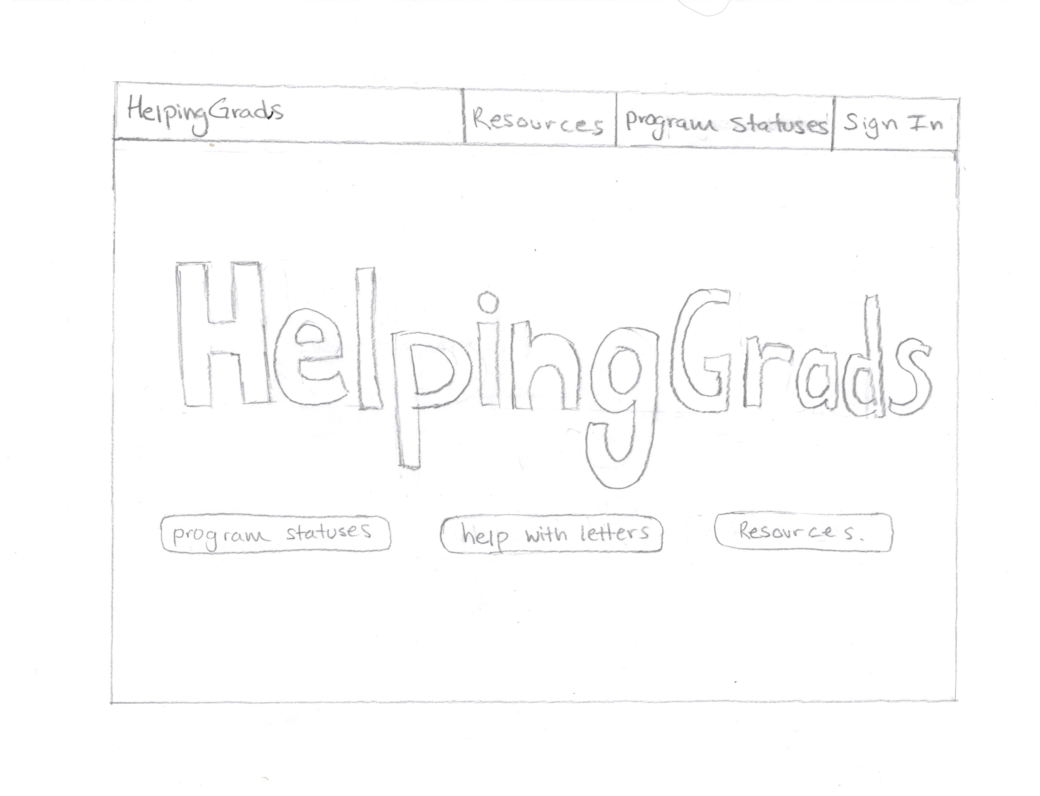
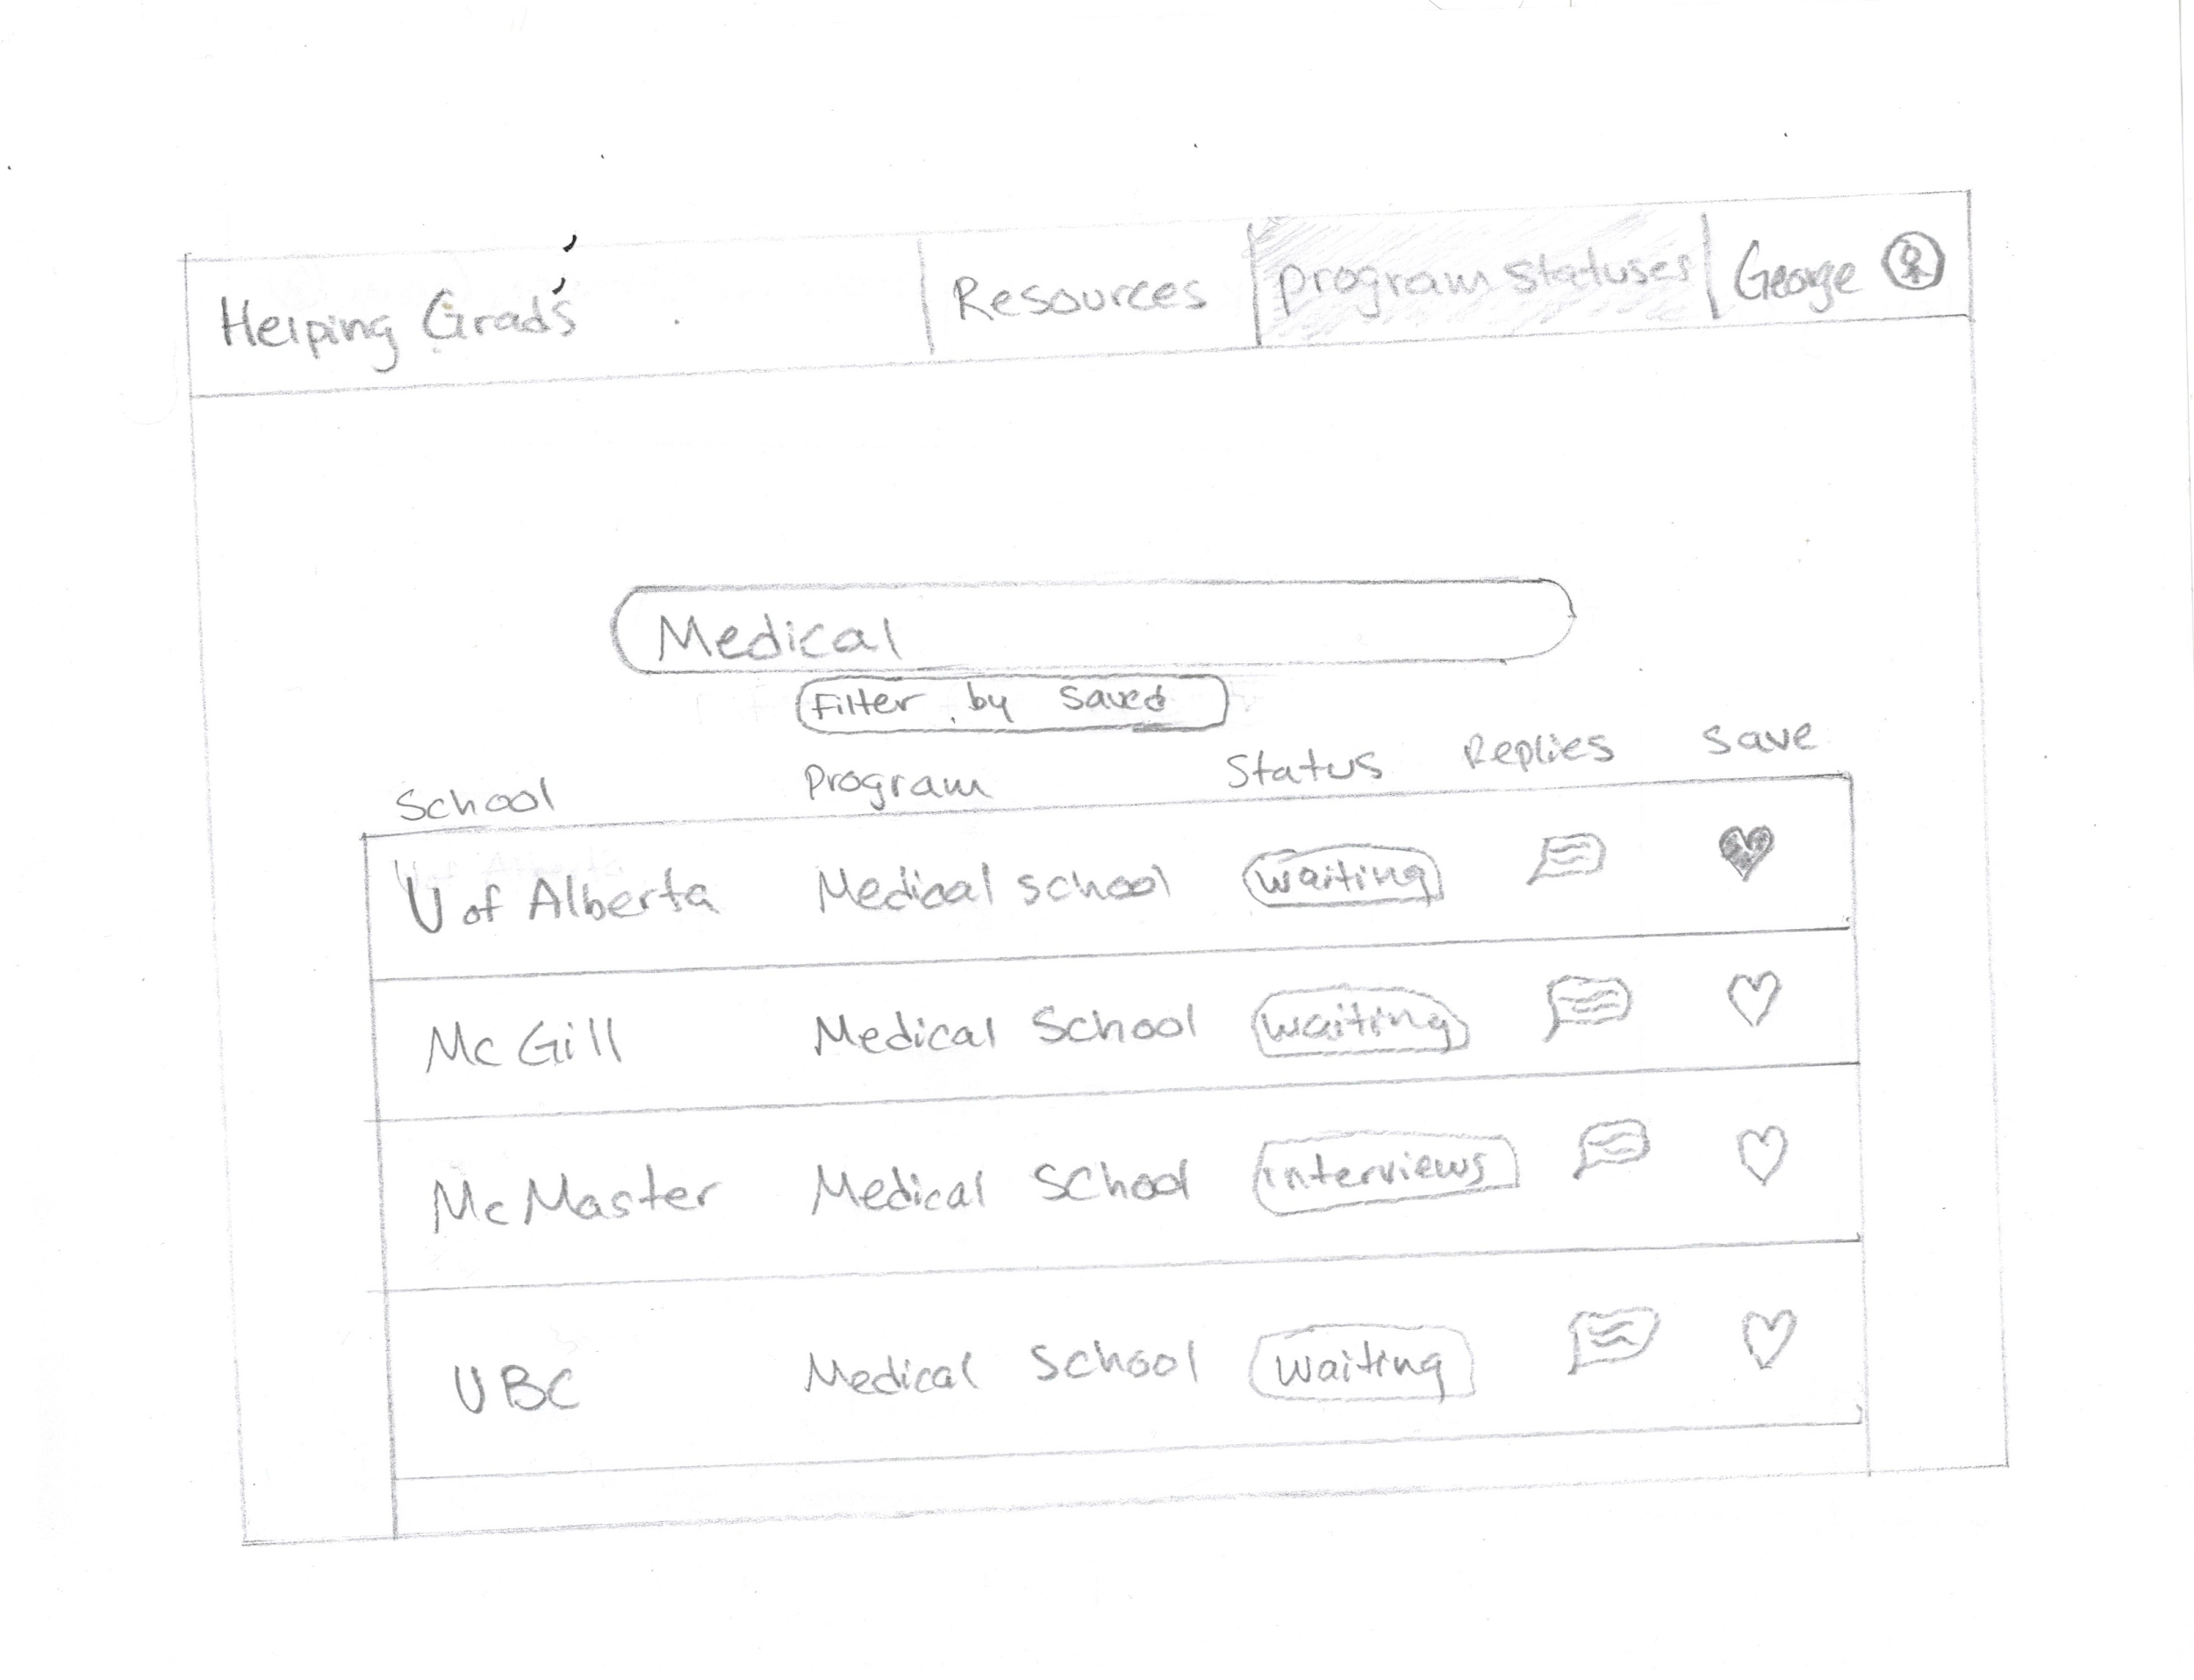
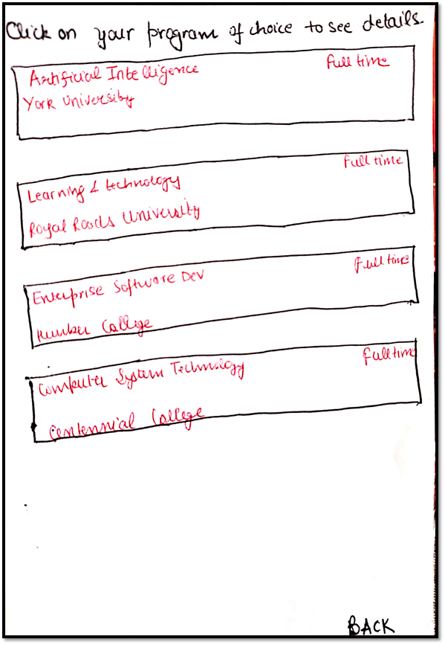
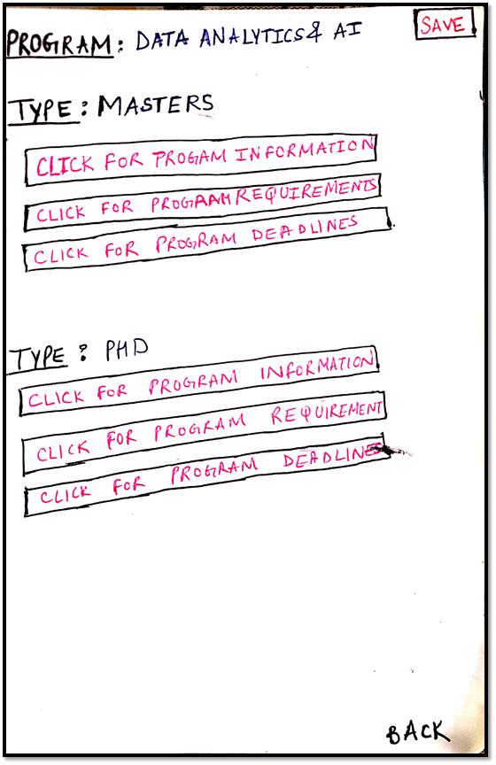
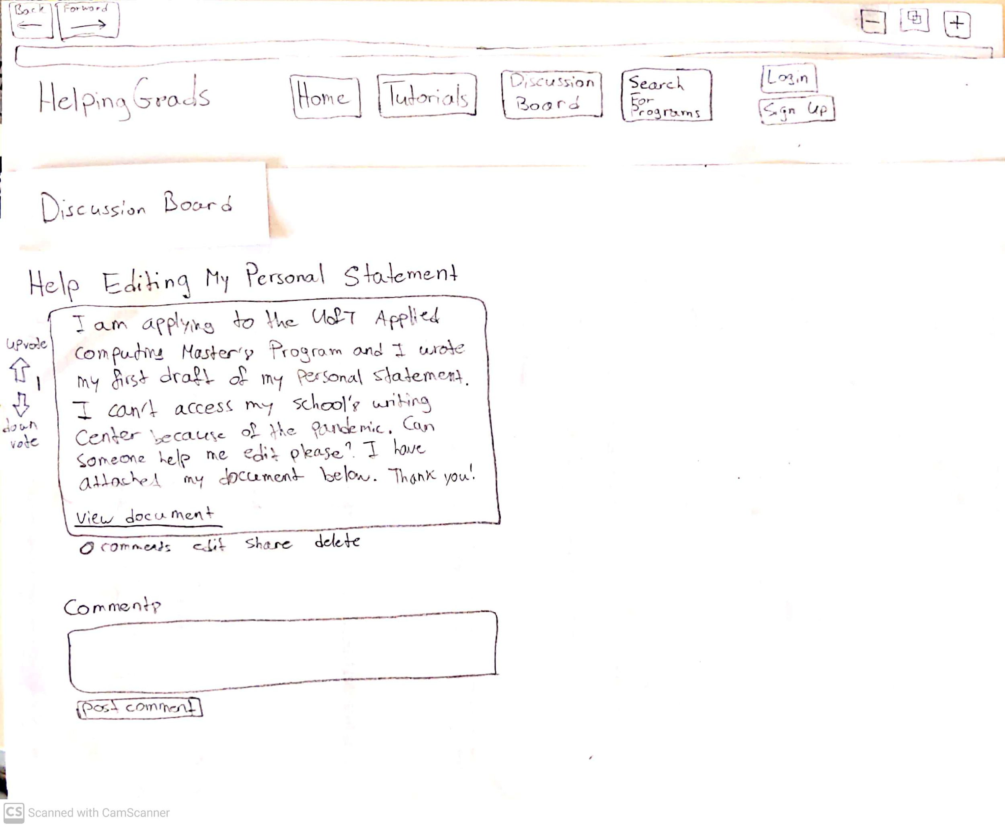
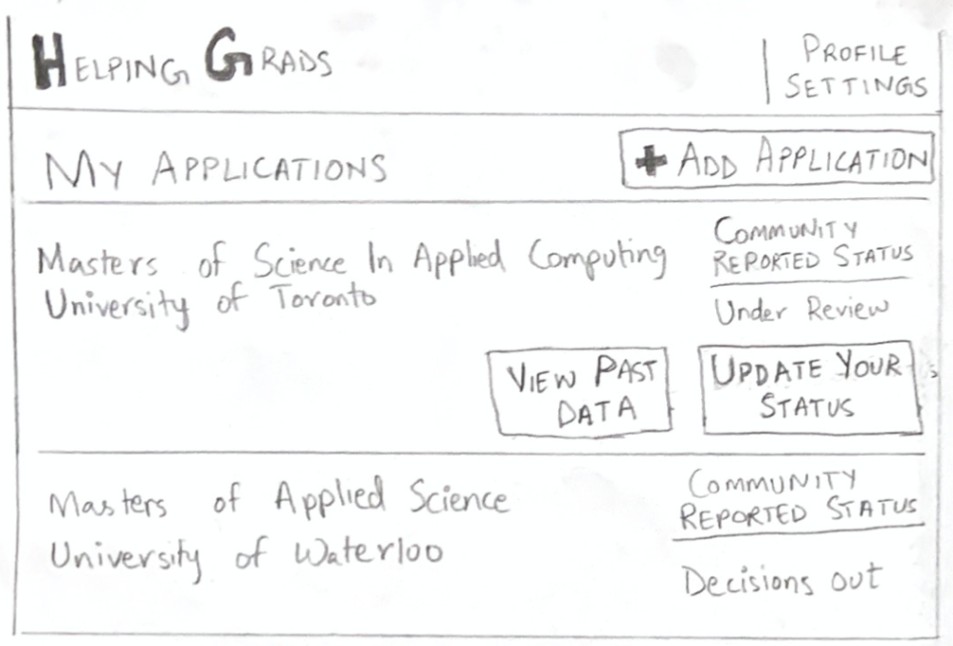
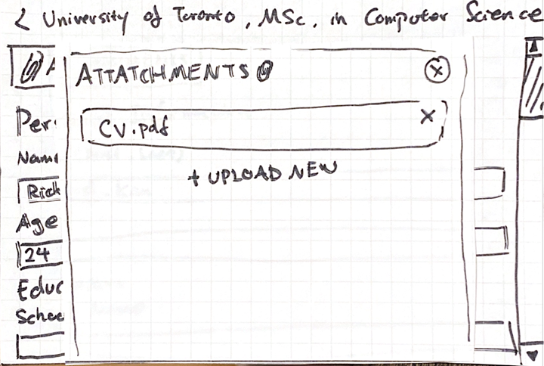
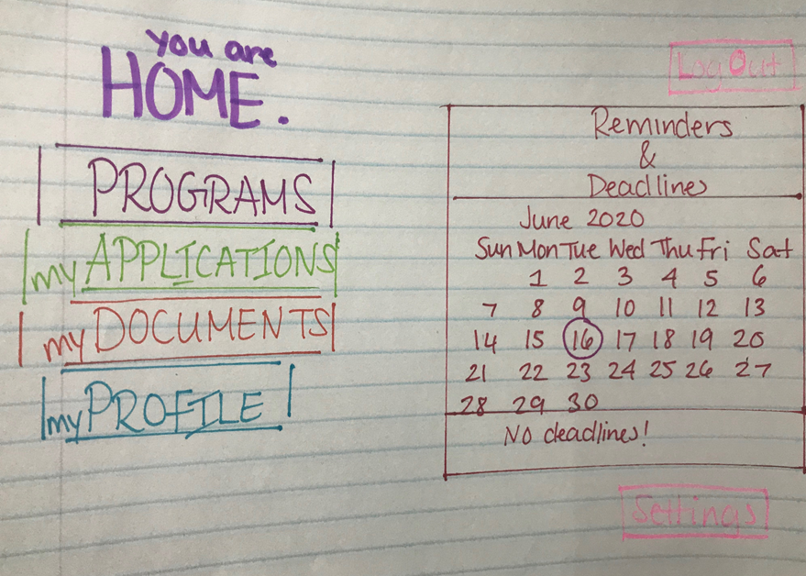
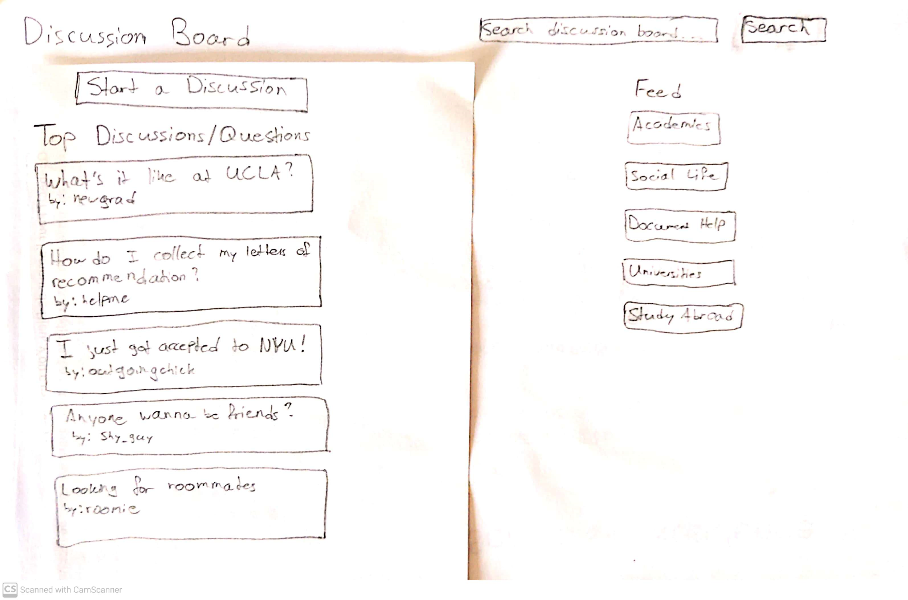
Individual Low-Fi Prototype
Gaurav’s Low-Fi
Muskan’s Low-Fi
Sharjeel’s Low-Fi
Jun’s Low-Fi
Nikisha’s Low-Fi
Shamanth’s Low-Fi
Notes:
Each of us had a different vision of what the prototype would look like. Here are just some key and unique pieces we found from our individual low-fi prototypes. We were able to take these pieces and use them for our combined low-fi prototype. Some of them also inspired new ideas for our combined prototype.

Slide 12
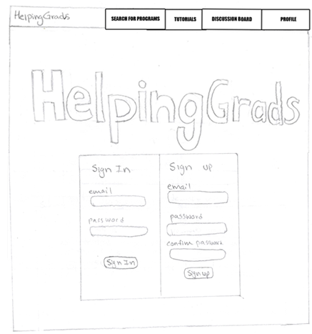
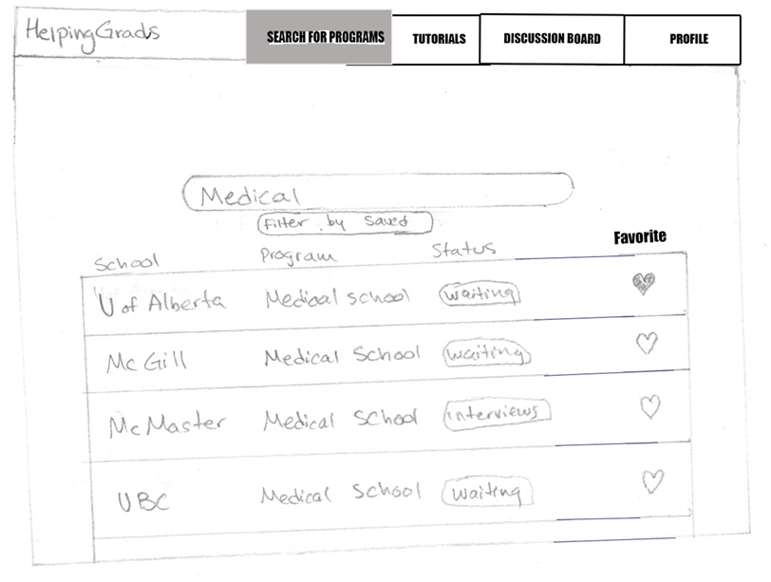
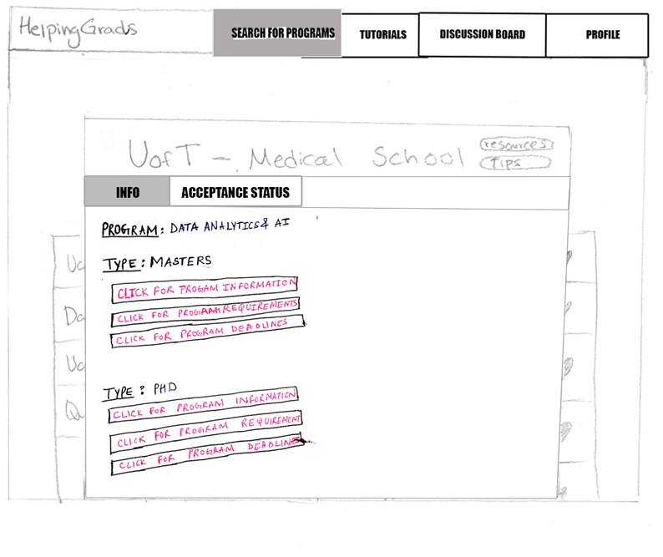
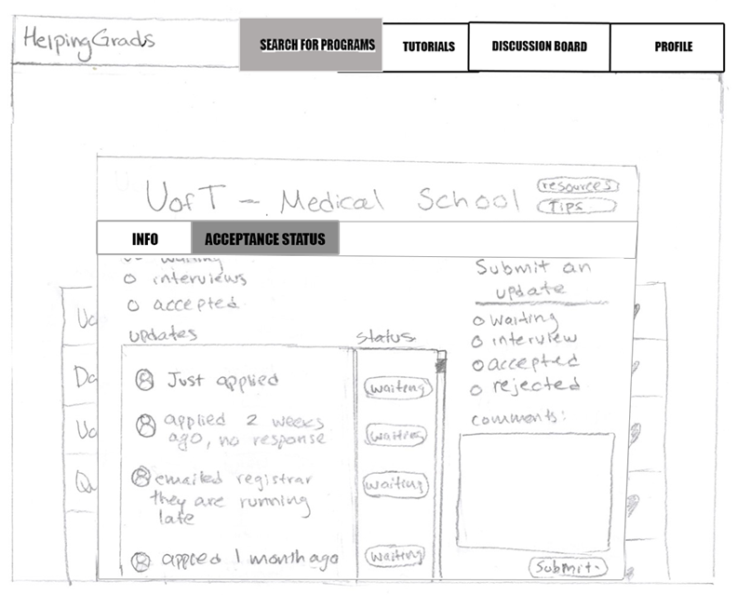
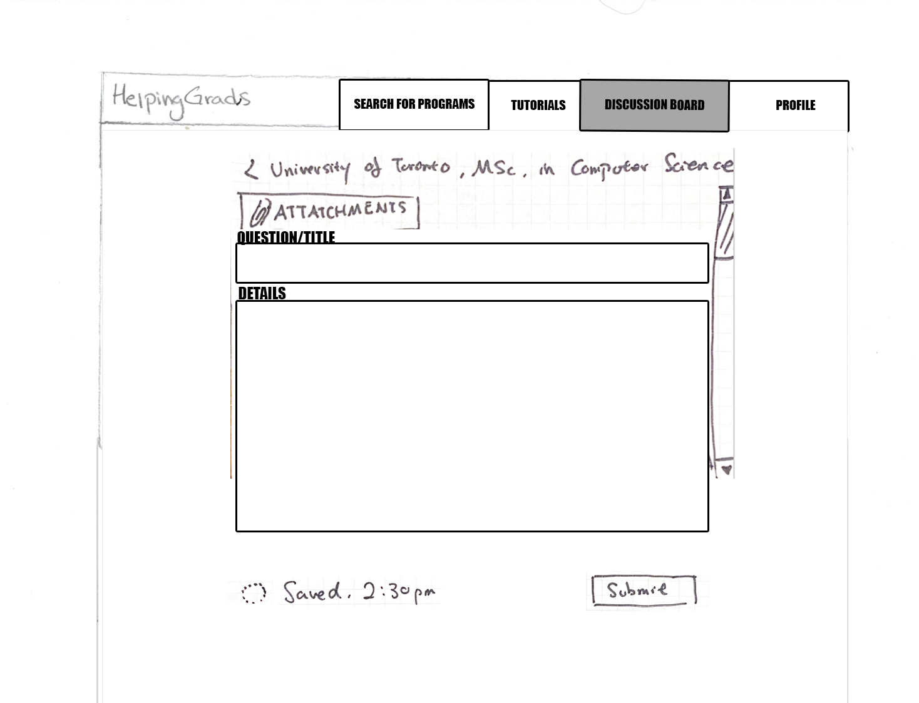
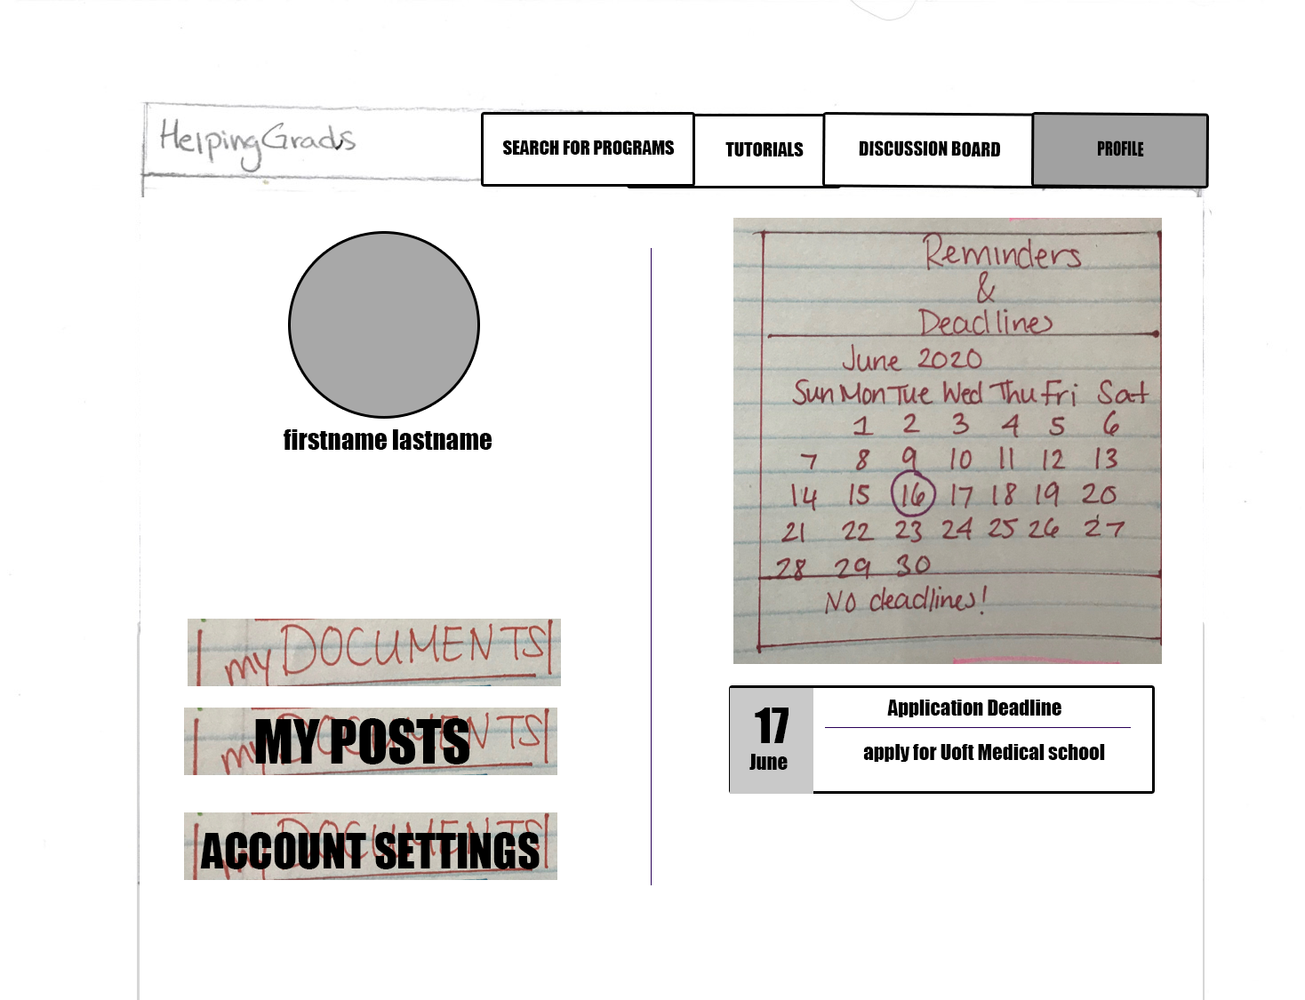
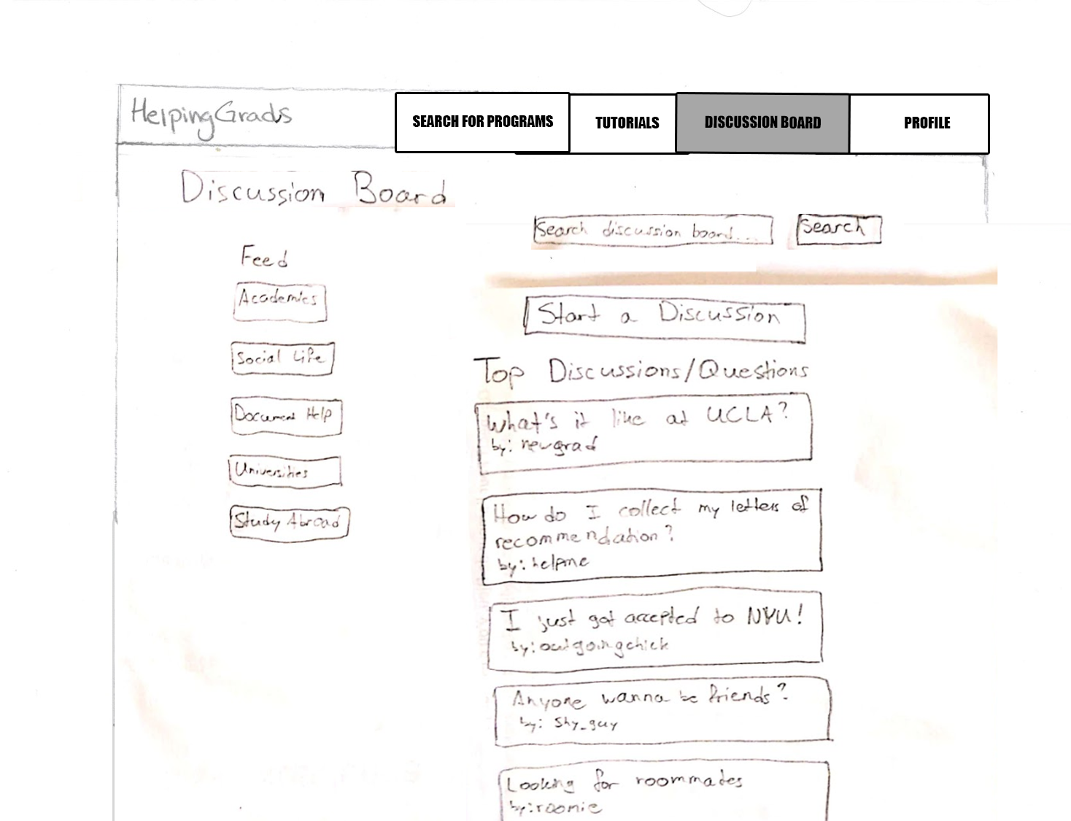
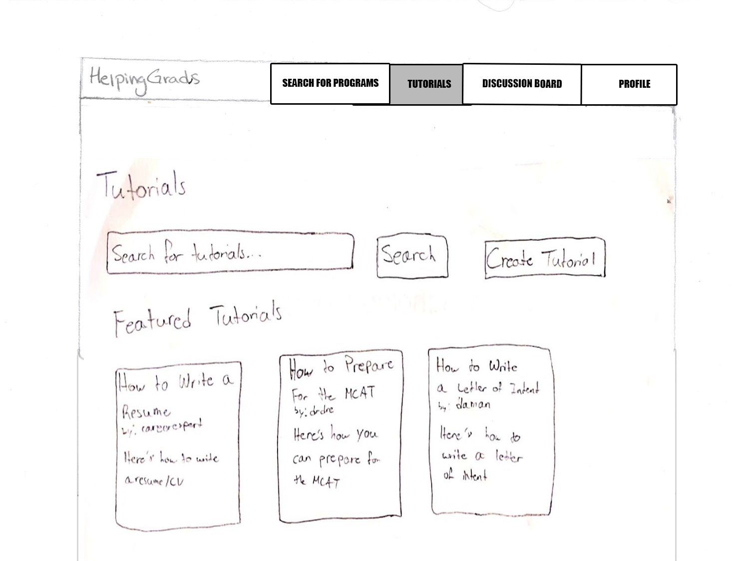
Combined Low-Fi Prototype
Notes:
Combined different features and components from everyone’s individual low-fi prototype and here are the key pages from our prototype.

Slide 13
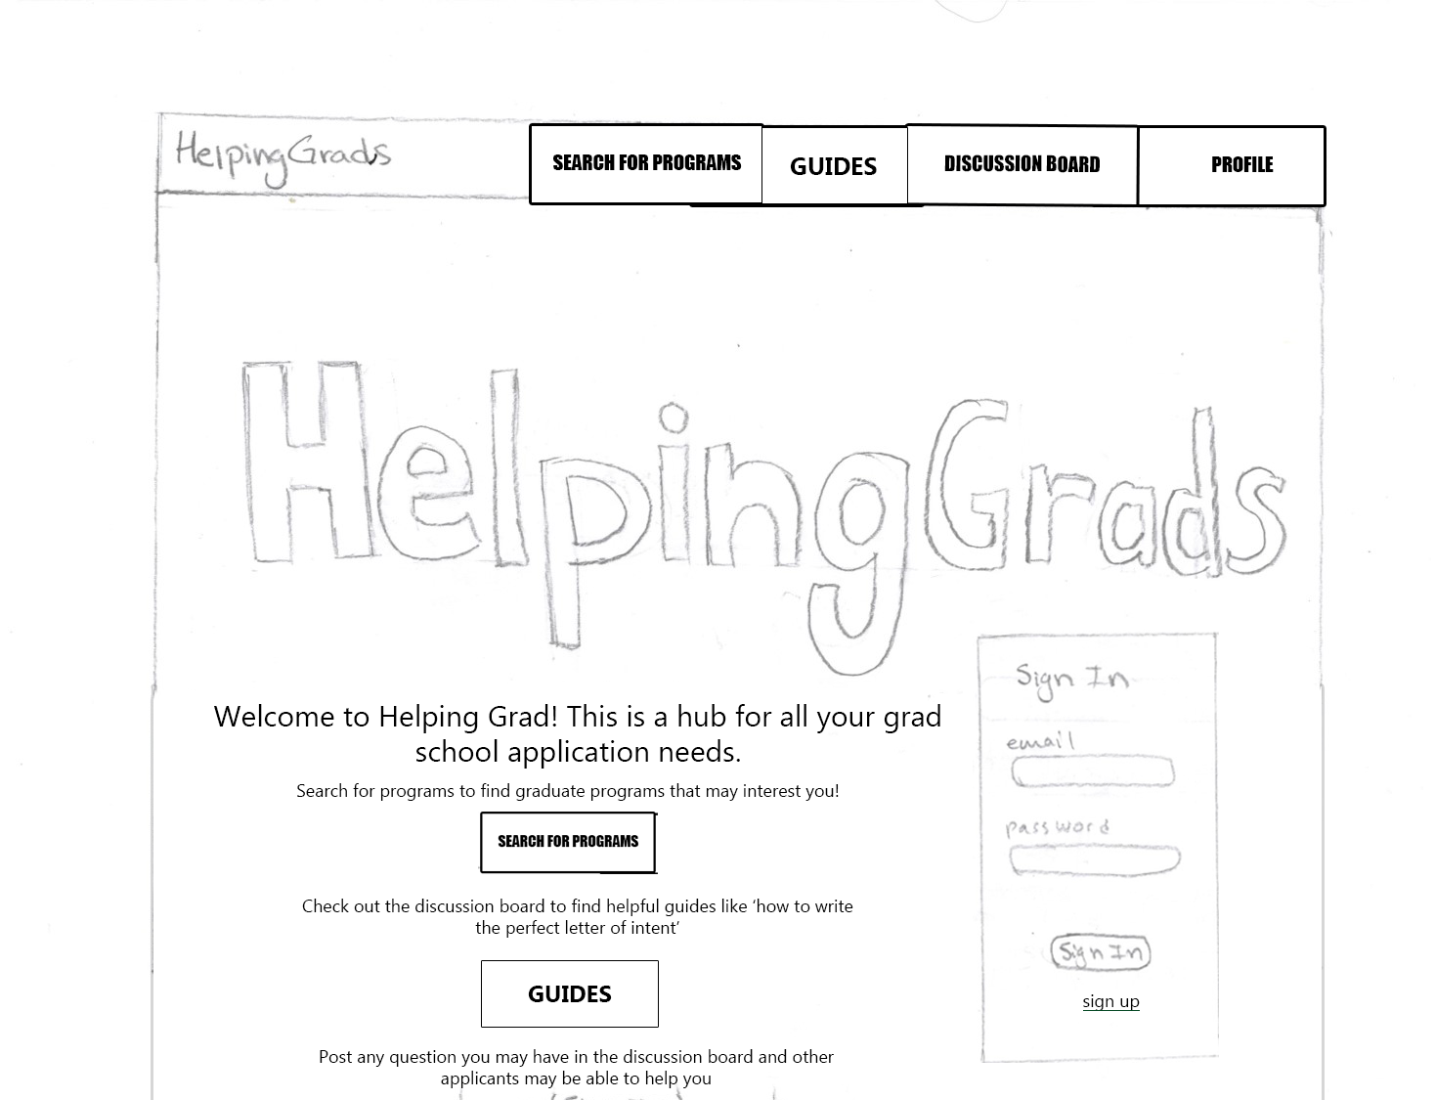
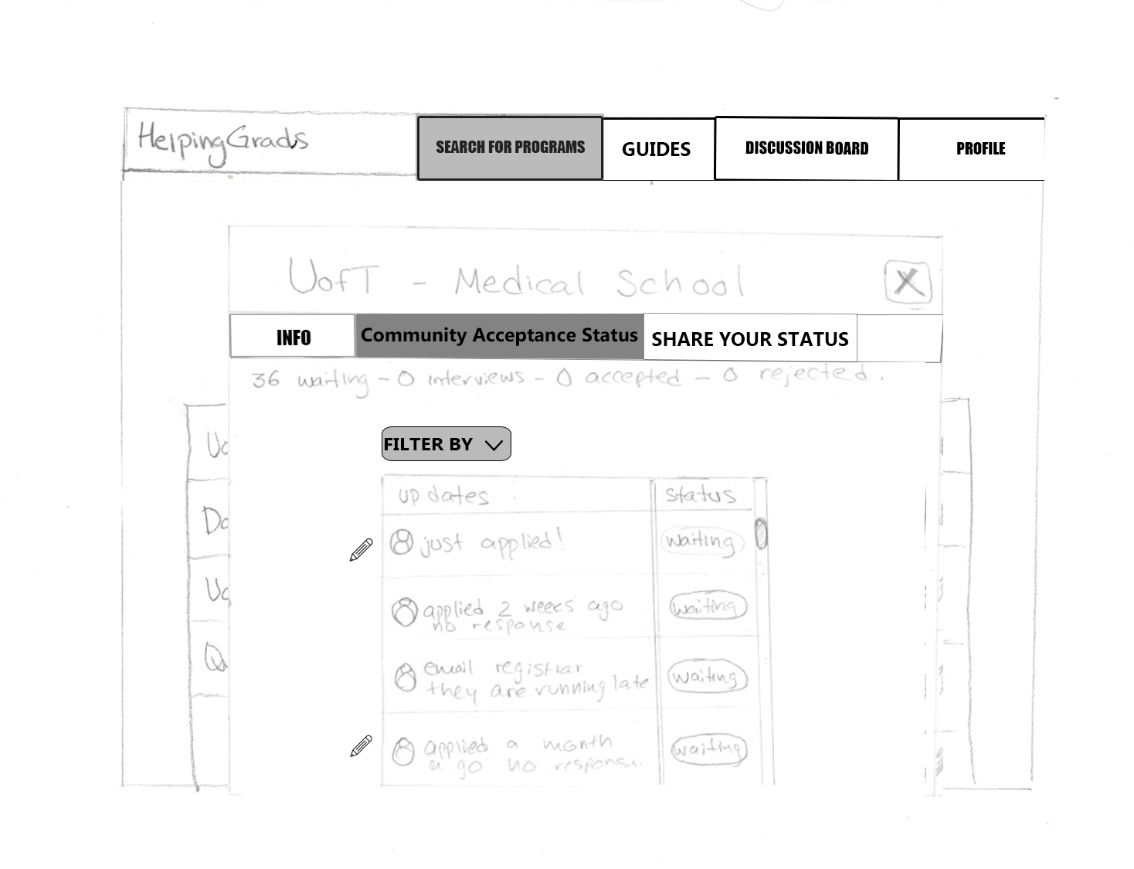
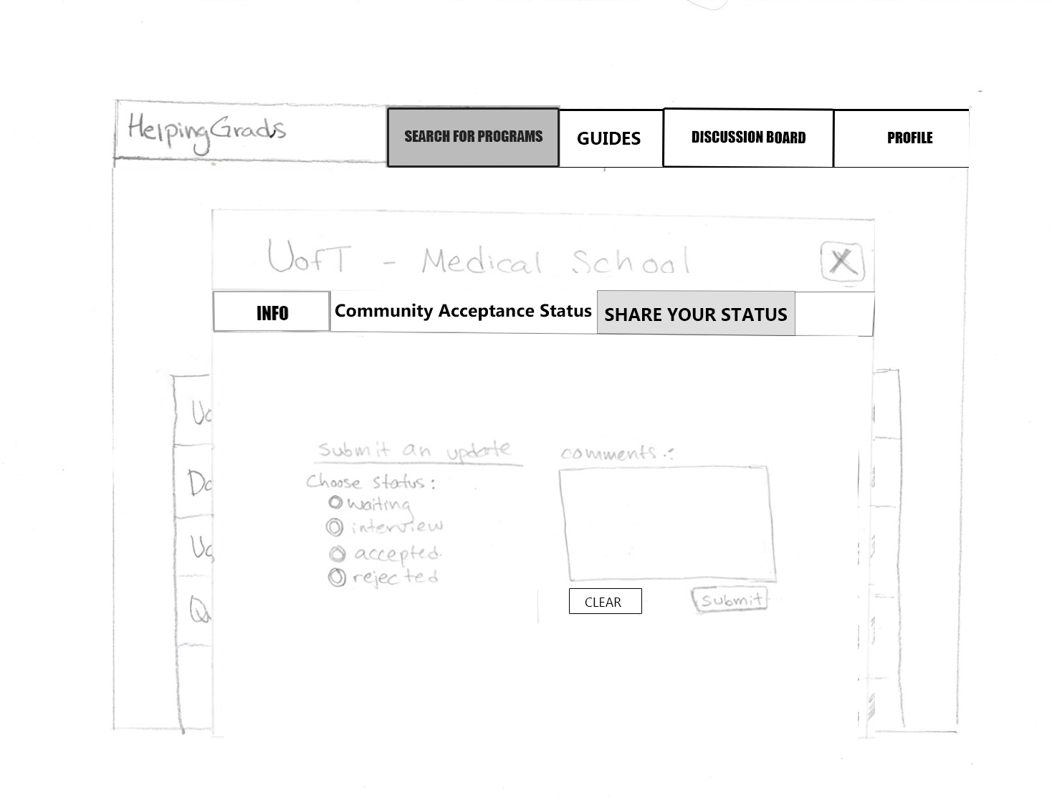
Combined Low-Fi Prototype (Refined)
Notes:
After a cognitive walkthrough and heuristic evaluation we were able to identify issues and their severity and were able to address them and find fixes for them and we came to a collective decision. Here is an example of the few pages we’ve made changes to in our low-fi prototype. The home page layout is much different than what we had earlier and we have a modal that was split up into different tabs whereas earlier we had one tab containing too much information.

Slide 14
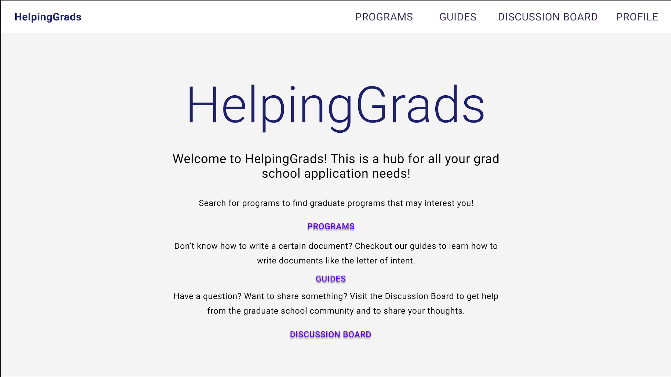
Hi-Fi Prototype
Notes:
Going from our low-fi prototype we were able to create our hi-fi prototype. Our aim was to create a simple and clean UI and we wanted to make sure our application was easy to navigate. We wanted to do this without overwhelming our users with large amounts of information.

Slide 15
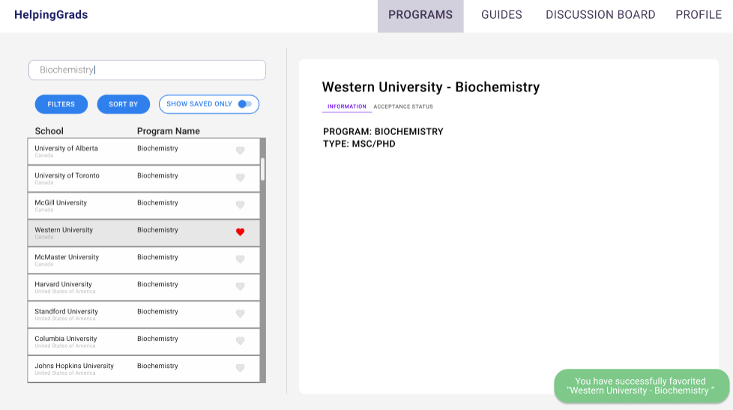
Hi-Fi Prototype
Notes:
This is the page where users can search for graduate school programs, get information about them such as the requirements and save them.

Slide 16
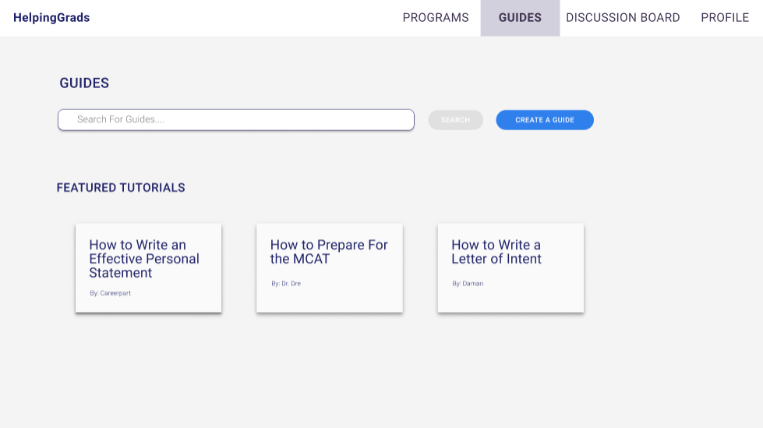
Hi-Fi Prototype
Notes:
Here is a page that contains guides for users to read and learn how to write certain documents such as a personal statement.

Slide 17
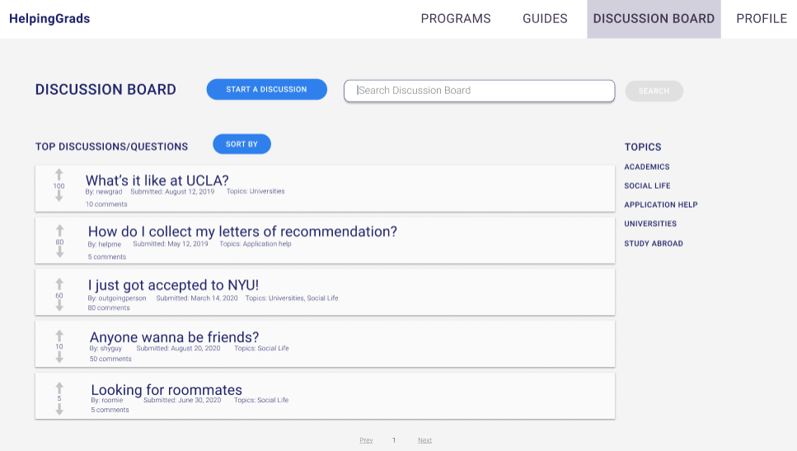
Hi-Fi Prototype
Notes:
Here is a discussion board which allows the users to communicate with the graduate school community. We wanted to create something that was a mix of Reddit and Stackoverflow. People can ask questions, give advice, share thoughts and get help from other users.

Slide 18
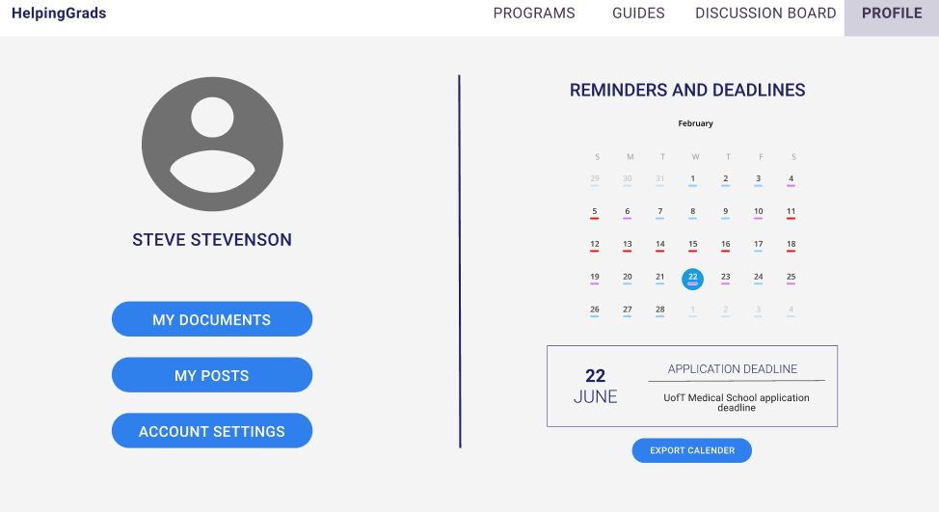
Hi-Fi Prototype
Notes:
Here is the user’s profile page where they can see their account details. There is also a calendar to remind users about their application deadlines. These are created when a user saves a program they have searched. They have the option to export this calendar so they can add to their personal calendar.

Slide 19
Usability Testing Results
Most of our participants found our application easy to navigate
Search for program information and saving the program for later
Creating guides to help other users
Viewing personal documents that you’ve uploaded
One aspect our users found challenging was commenting on a user’s post in order to help them
Possibly due a misinterpretation of the given task
Notes:
From our usability testing results, we concluded that all of our participants found our application easy to navigate. They found searching for program information, saving programs for later, creating guides to help other users and viewing personal documents particularly easy to do. One thing that they found a little challenging was helping other users as our questions were open to interpretation. For example, in one task the expected action was to comment on another user’s post but instead some participants thought of creating a guide. And for another where the expected action was to create a guide, participants would do the opposite and comment on a user’s post. This also showed how differently our participants think, as some interpreted the questions differently than others.

Slide 20
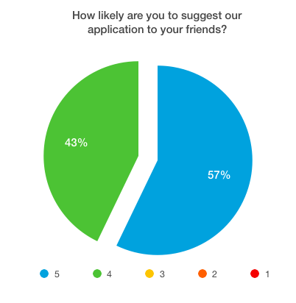
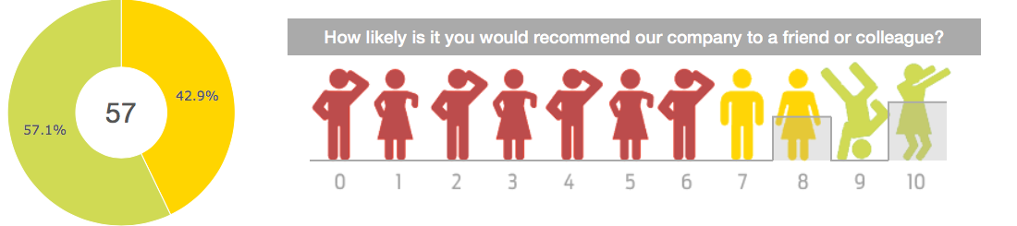
Usability Test Findings
Here we can see our results from participants when asked if they were likely to recommend our application to others. We can observe that from our results on the pie chart, our Net Promoter Score (NPS) is 57.
Notes:
Here we can see our results from participants when asked if they were likely to recommend our application to others. We can observe that from our result on the pie chart, our Net Promoter Score (NPS) is 57. A good NPS score is between 0 and 100 and we have a pretty high score of 57 which means our participants would be more likely to recommend our application.

Slide 21
Reflections
Originally was supposed to be a central hub for all graduate school applications
Unrealistic
Removed because it was not the actual problem
Refined original solution to only address the actual problems
Notes:
As mentioned earlier our original solution was a centralized hub but this was unrealistic and it wasn’t the actual problem. So we pivoted to our current solution which was to create a space where people can get access to resources that can help them prepare their application.

Slide 22
Positive Impacts
A place to ask all your grad school related questions
Users loved the fact that we had multiple features all in one place (program info, acceptance status info, guides and discussions with other grad applicants)
Reduces stress
Saves time and energy
Notes:
Some positive impacts were that users loved the fact that all their grad school related questions can be answered on our application, the multiple features our application had including program information, acceptance status info, guides and discussions with other grad applicants, our website can help users reduce stress as well as save time and energy on creating their application.

Slide 23
THANKS!
Any questions?

